Slide 1
SECURE PACKET FORWARDING IN CLOUD-BASED IoT The mechanisms which prevent packet forwarding from attacks:
SMART
TCBI
Secure credit-based incentive scheme
Pi does not consider the outsider threats.
Layer adding collision cannot be solved in both SMART and Pi.
Threshold credit-based incentive mechanism
Node compromise attacks are blocked effectively
Equality between IoT users is provided
Optimize IoT users’ utility

Slide 2
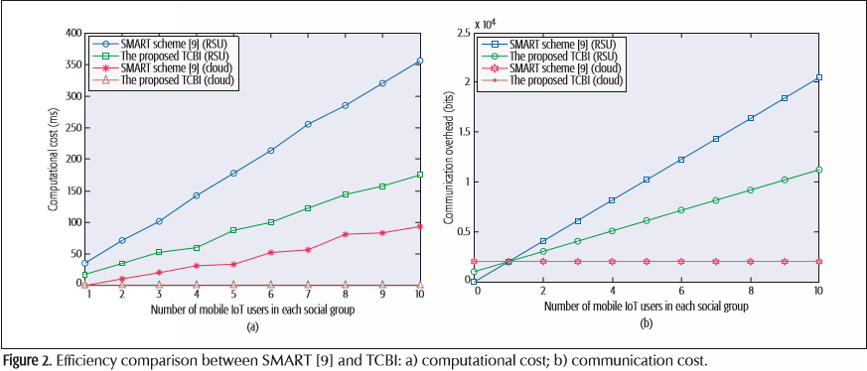
Comparison of SMART and TCBI

Slide 3
PRIVACY-PRESERVING AUTHENTICATION IN CLOUD-BASED IoT
Identity/location privacy protection
Lightweight authentication
Pseudonym technique is proposed instead of Public Key Infrastructure (PKI).

Slide 4
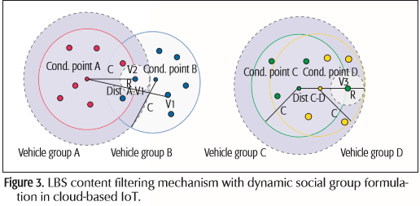
SAVE
An efficient privacy preserving authentication scheme
It filters location based service contents.
Prevents duplicate elements
Physically dynamic tracing attack is prevented

Slide 5
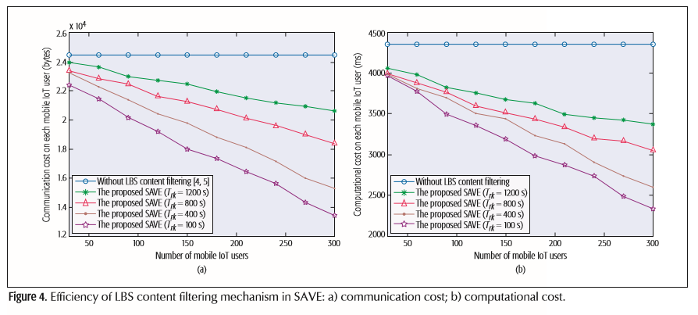
Efficiency of LBS content filtering mechanism in SAVE

